Slide 1
ubitricity CryptoCharging
Blockchain Ethereum Dapp

Slide 2
CONTENTS
Blockchain 101
Ethereum
Three “Levels” of Blockchain
How Smart Contracts Work?
Market Analysis
How can ubitricity take advantage of Blockchain Technology?
Future Products worth Consideration

Slide 3
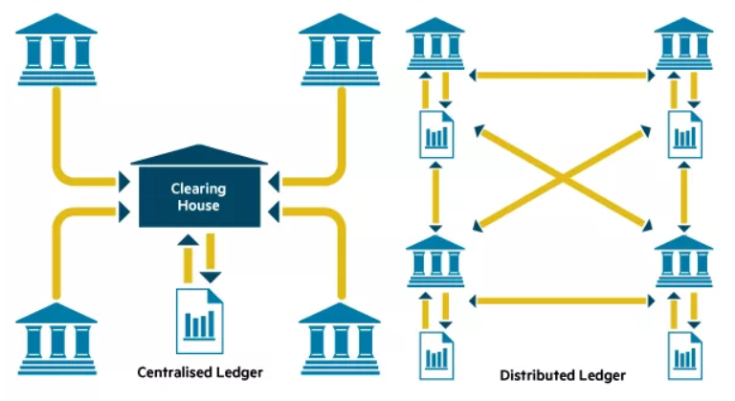
Blockchain 101
Blockchain is a distributed ledger for recording the history of transactions - that cannot be altered.

Slide 4
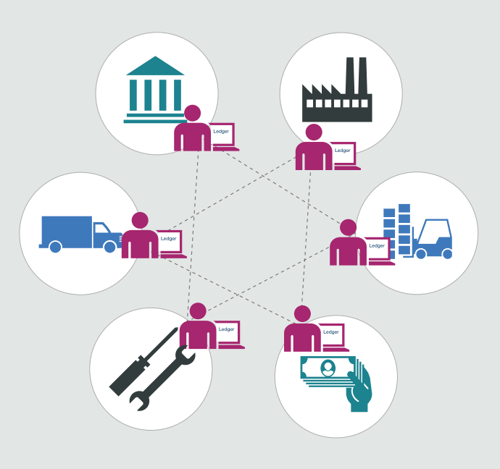
Blockchain 101 (Continued..)
Single shared ledger that is tamper-evident. Once recorded, transactions cannot be altered
All parties must give consensus before a new transaction is added to the network
Eliminates or reduces paper processes, speeding up transaction times and increasing efficiencies

Slide 5
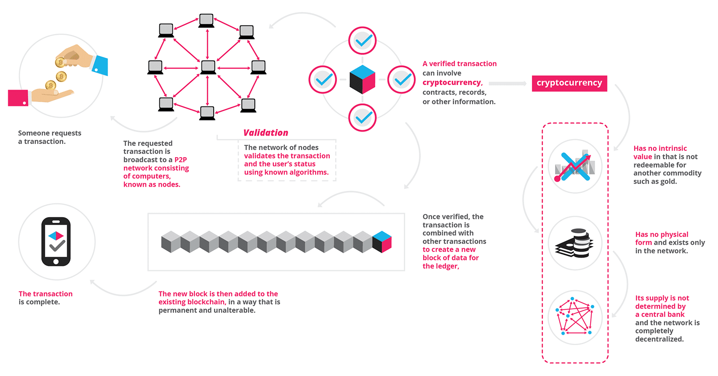

Slide 6
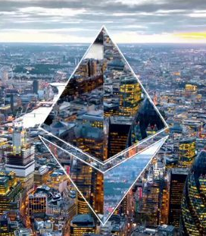
Ethereum
It is simply a World Computer, which is a platform for programmable incentive networks
Web 1.0 — Static Document Networks — web of static pages connected via hyperlinks.
Web 2.0 — Social Networks — web of people connected via social links(likes, follows).
Web 3.0 — Incentive Networks- web of people connected via economic links (tokens).

Slide 7
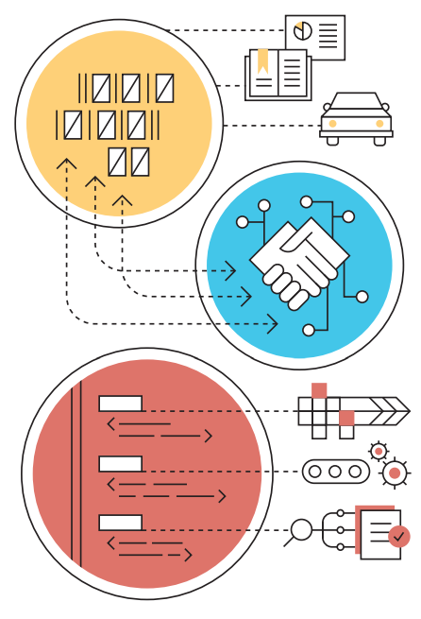
Three “Levels” of Blockchain
Storage for digital records
Exchanging digital assets (called tokens)
Executing smart contracts
Ground rules Terms & conditions recorded in code
Implementation Distributed network executes contract & monitors compliance
Verification Outcomes are automatically validated without third party

Slide 8
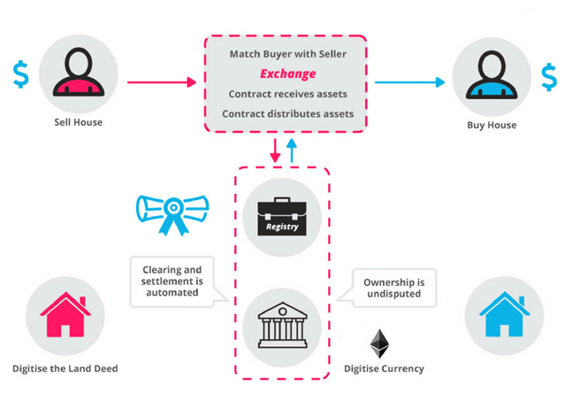
How Smart Contracts Work?

Slide 9
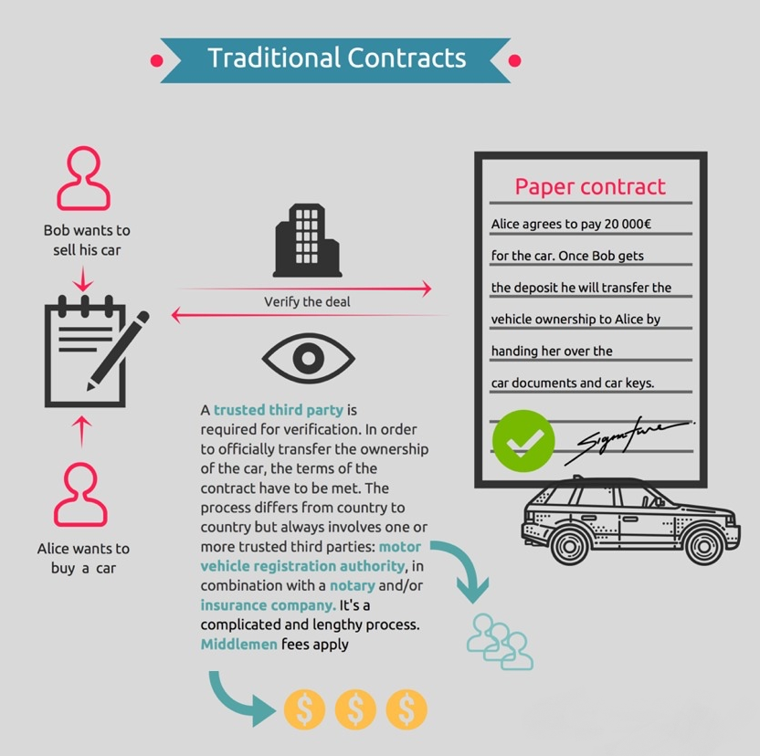

Slide 10
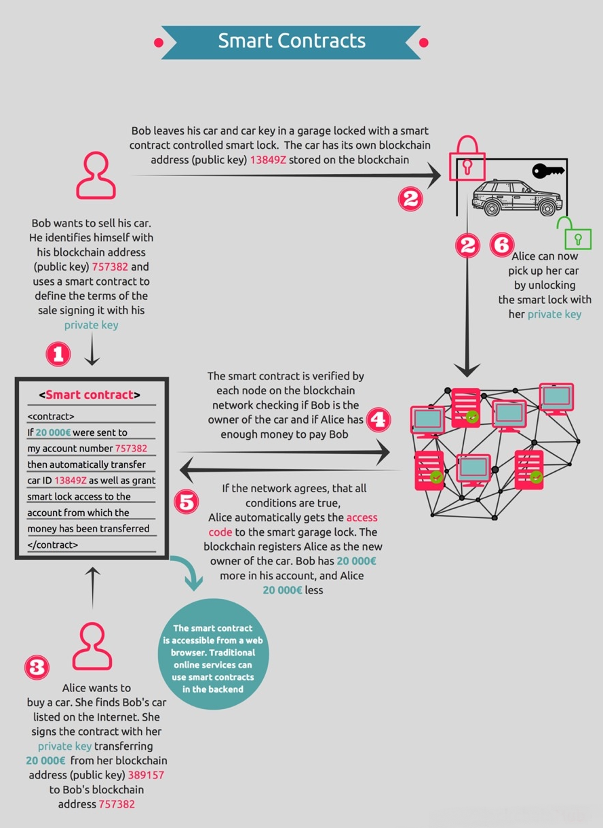

Slide 11
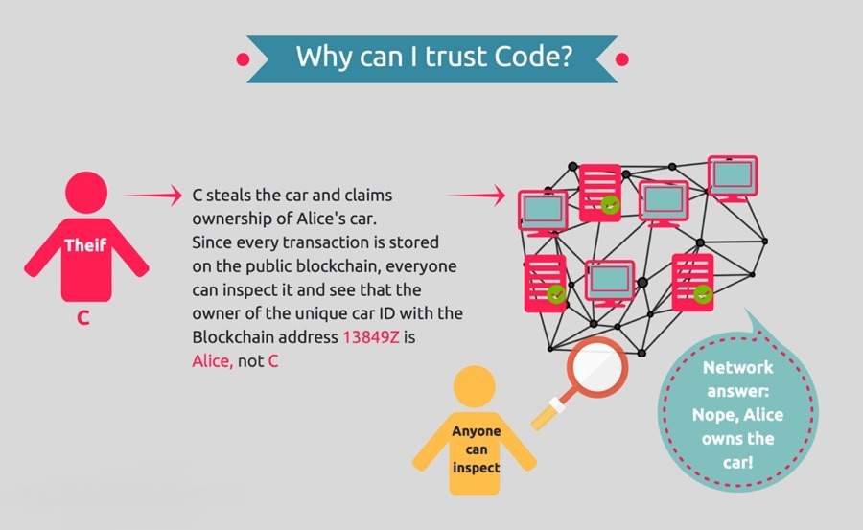

Slide 12
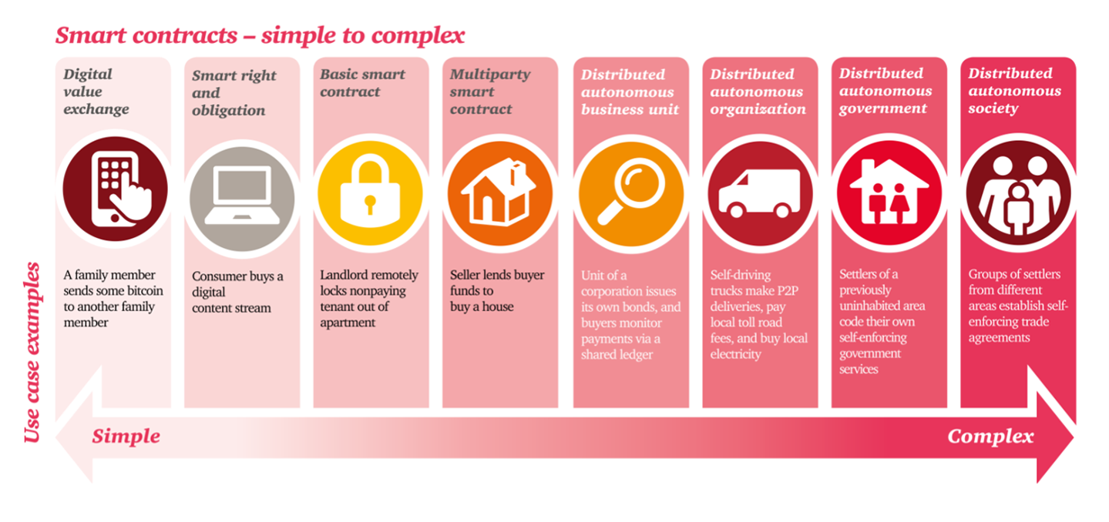

Slide 13
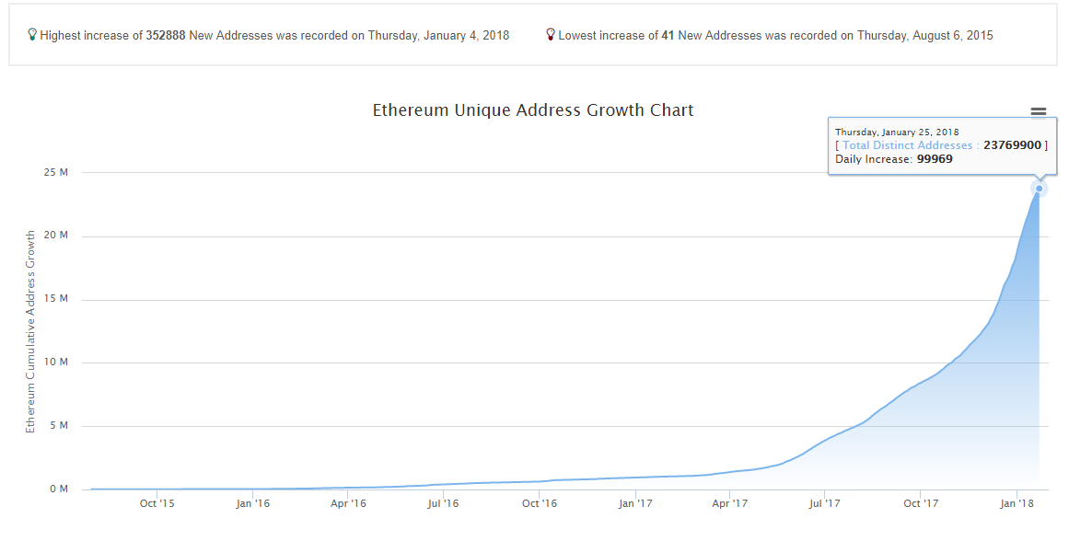
Market Analysis (Ethereum Network WorldWide)
Current Distinct Addresses – 24 million
Distinct Addresses Jan 2019 – 51 million (Assuming current growth rate of 100k users/day)

Slide 14
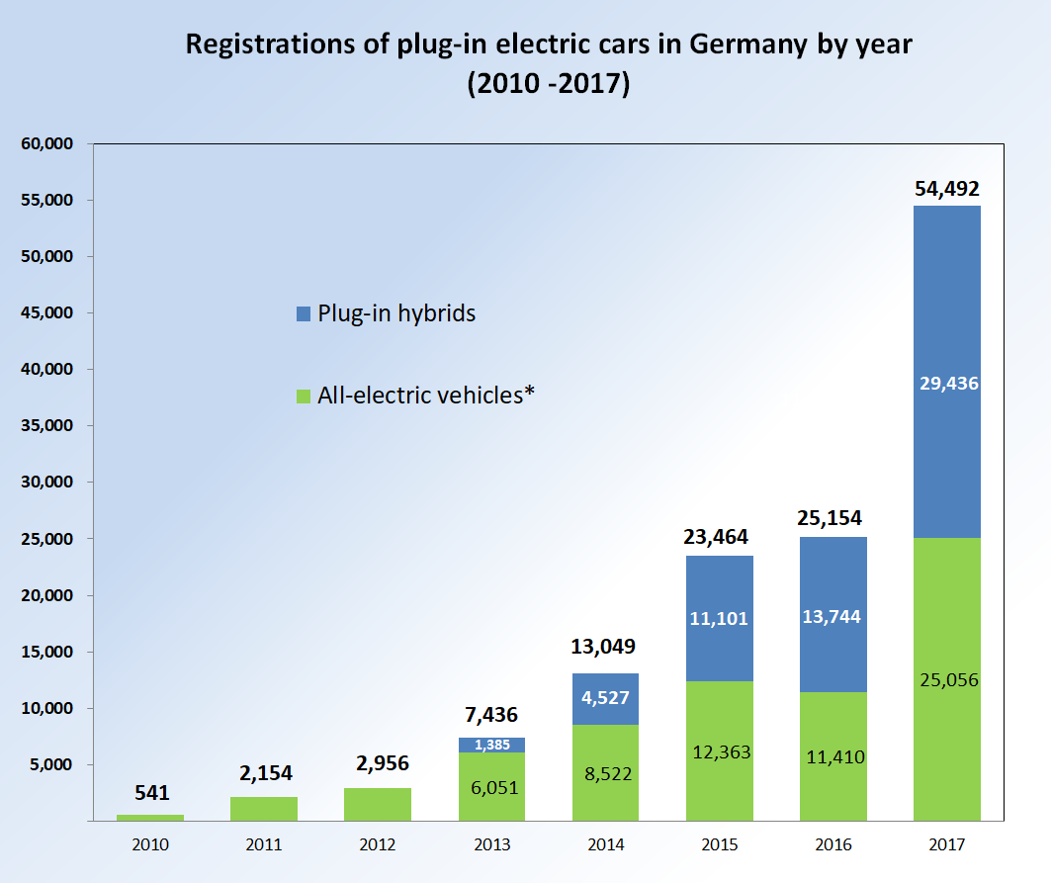
Market Analysis (Total EV in Germany)
Year on Year growth rate
Plug-In Hybrids – 114.2%
Electric Vehicles – 119.6 %
German government plans to meet a goal of 1 million EVs on road by 2020

Slide 15

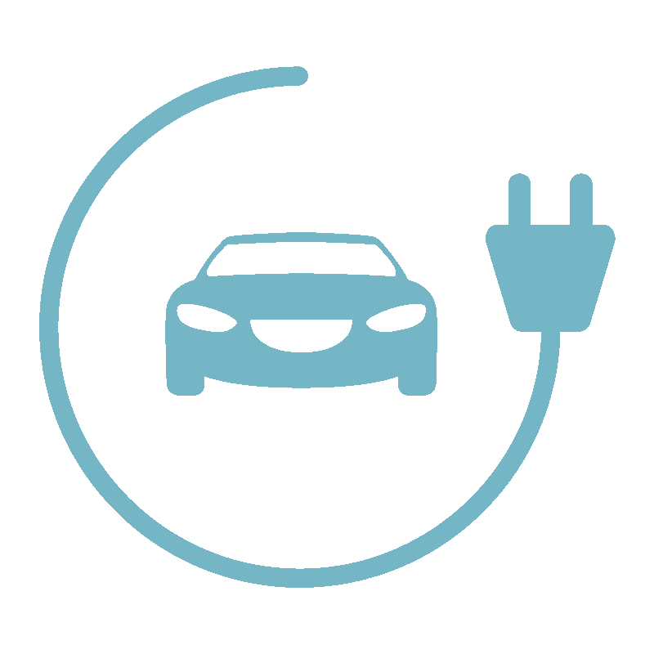
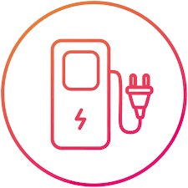

How can Ubitricity take advantage of Blockchain Technology?
New Payment Mode – Instead of using SOFORT or paypal or any other central banking agency to propagate payments from customers to us, we use ethereum network to cut out the middle man and increase incentives for our cutomers (and maybe a little for us too).

Slide 16
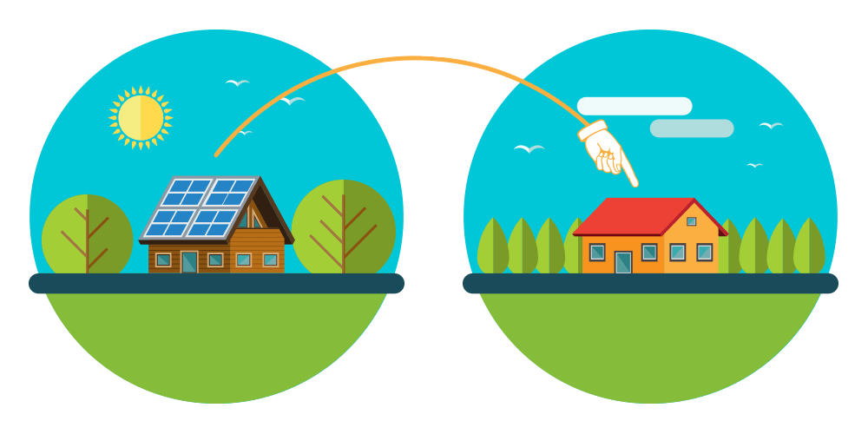
How can Ubitricity take advantage of Blockchain Technology? (Continued..)
Peer to Peer Energy Distribution Network - Develop community energy market and provide them with metering service for the trade to happen with the use of our blockchain tech to make it happen. This tech will come along a simple mobile app to do the trade, has ethereum wallet, show electricity usage and complete billing.

Slide 17



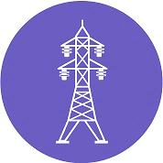
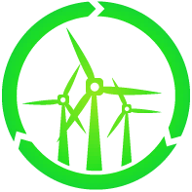

How can Ubitricity take advantage of Blockchain Technology? (Continued..)
Peer to Peer Energy Distribution Network
Electricity Producers
Charging Station Providers
Smart Grid

Slide 18
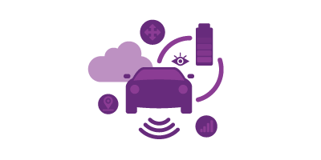
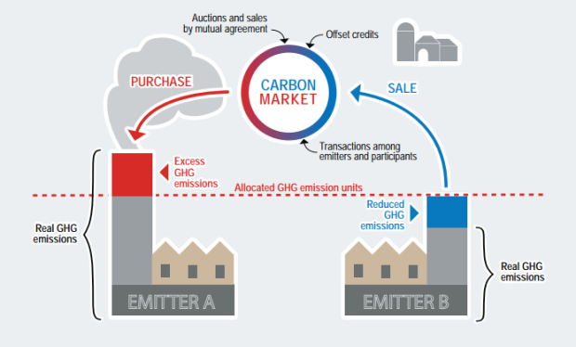
Future Products worth Consideration
Electric Car/ Carbon Trading

Slide 19
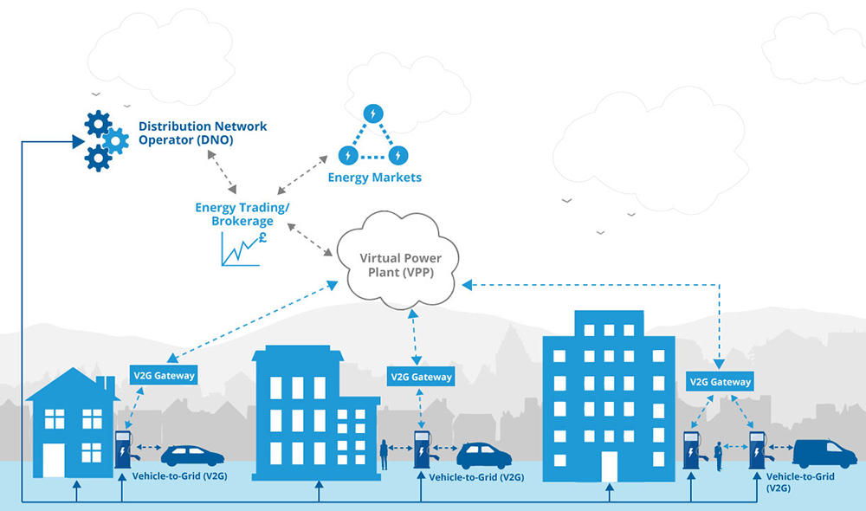
Future Products worth Consideration
Distributed Market Management/ Transmission Exchange

Slide 20
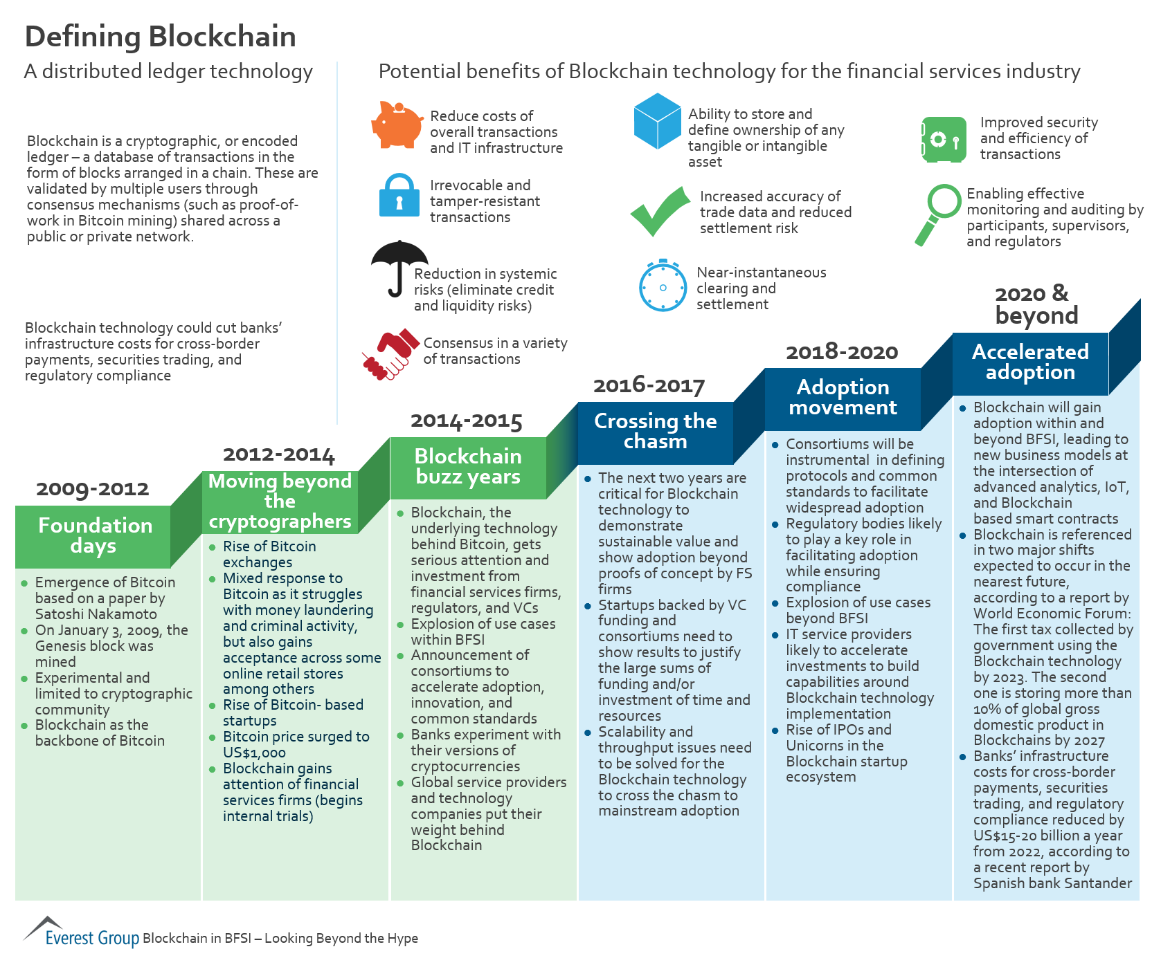

Slide 21
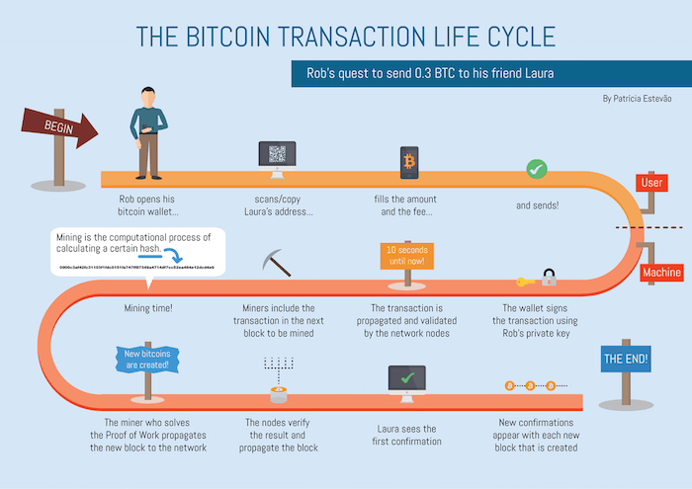

Slide 22
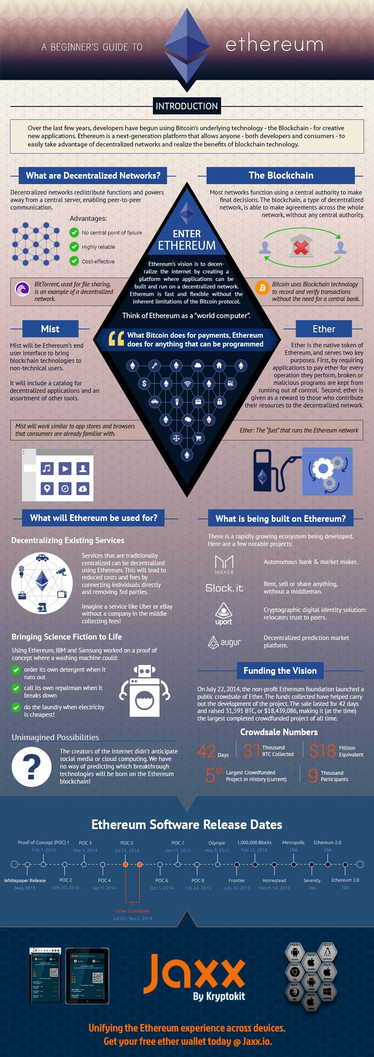
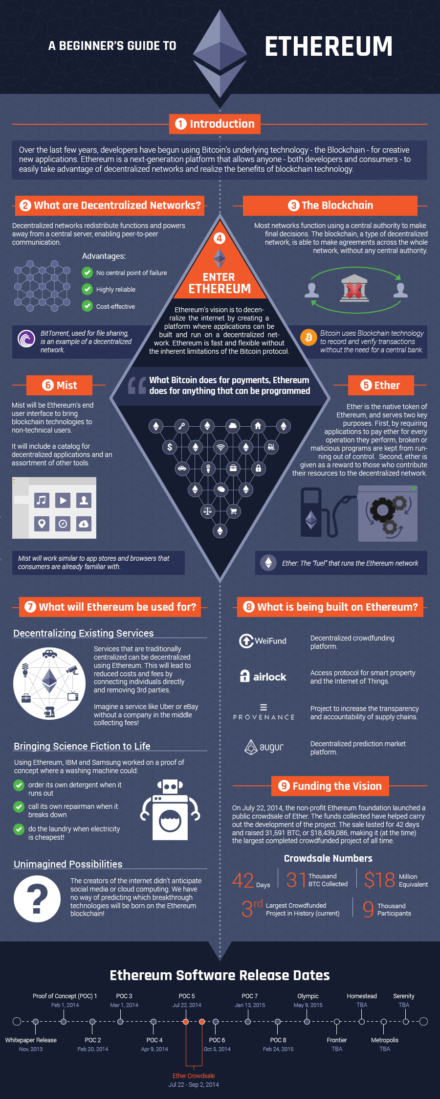

Slide 23
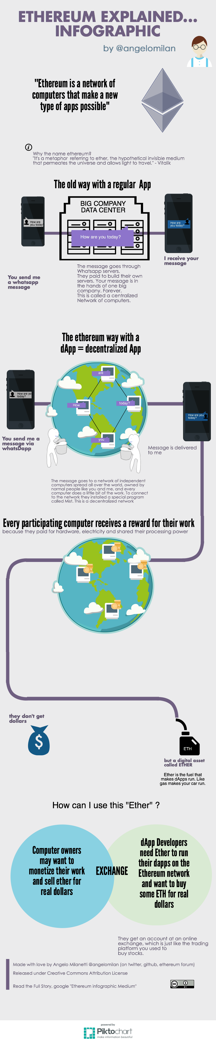

Slide 24
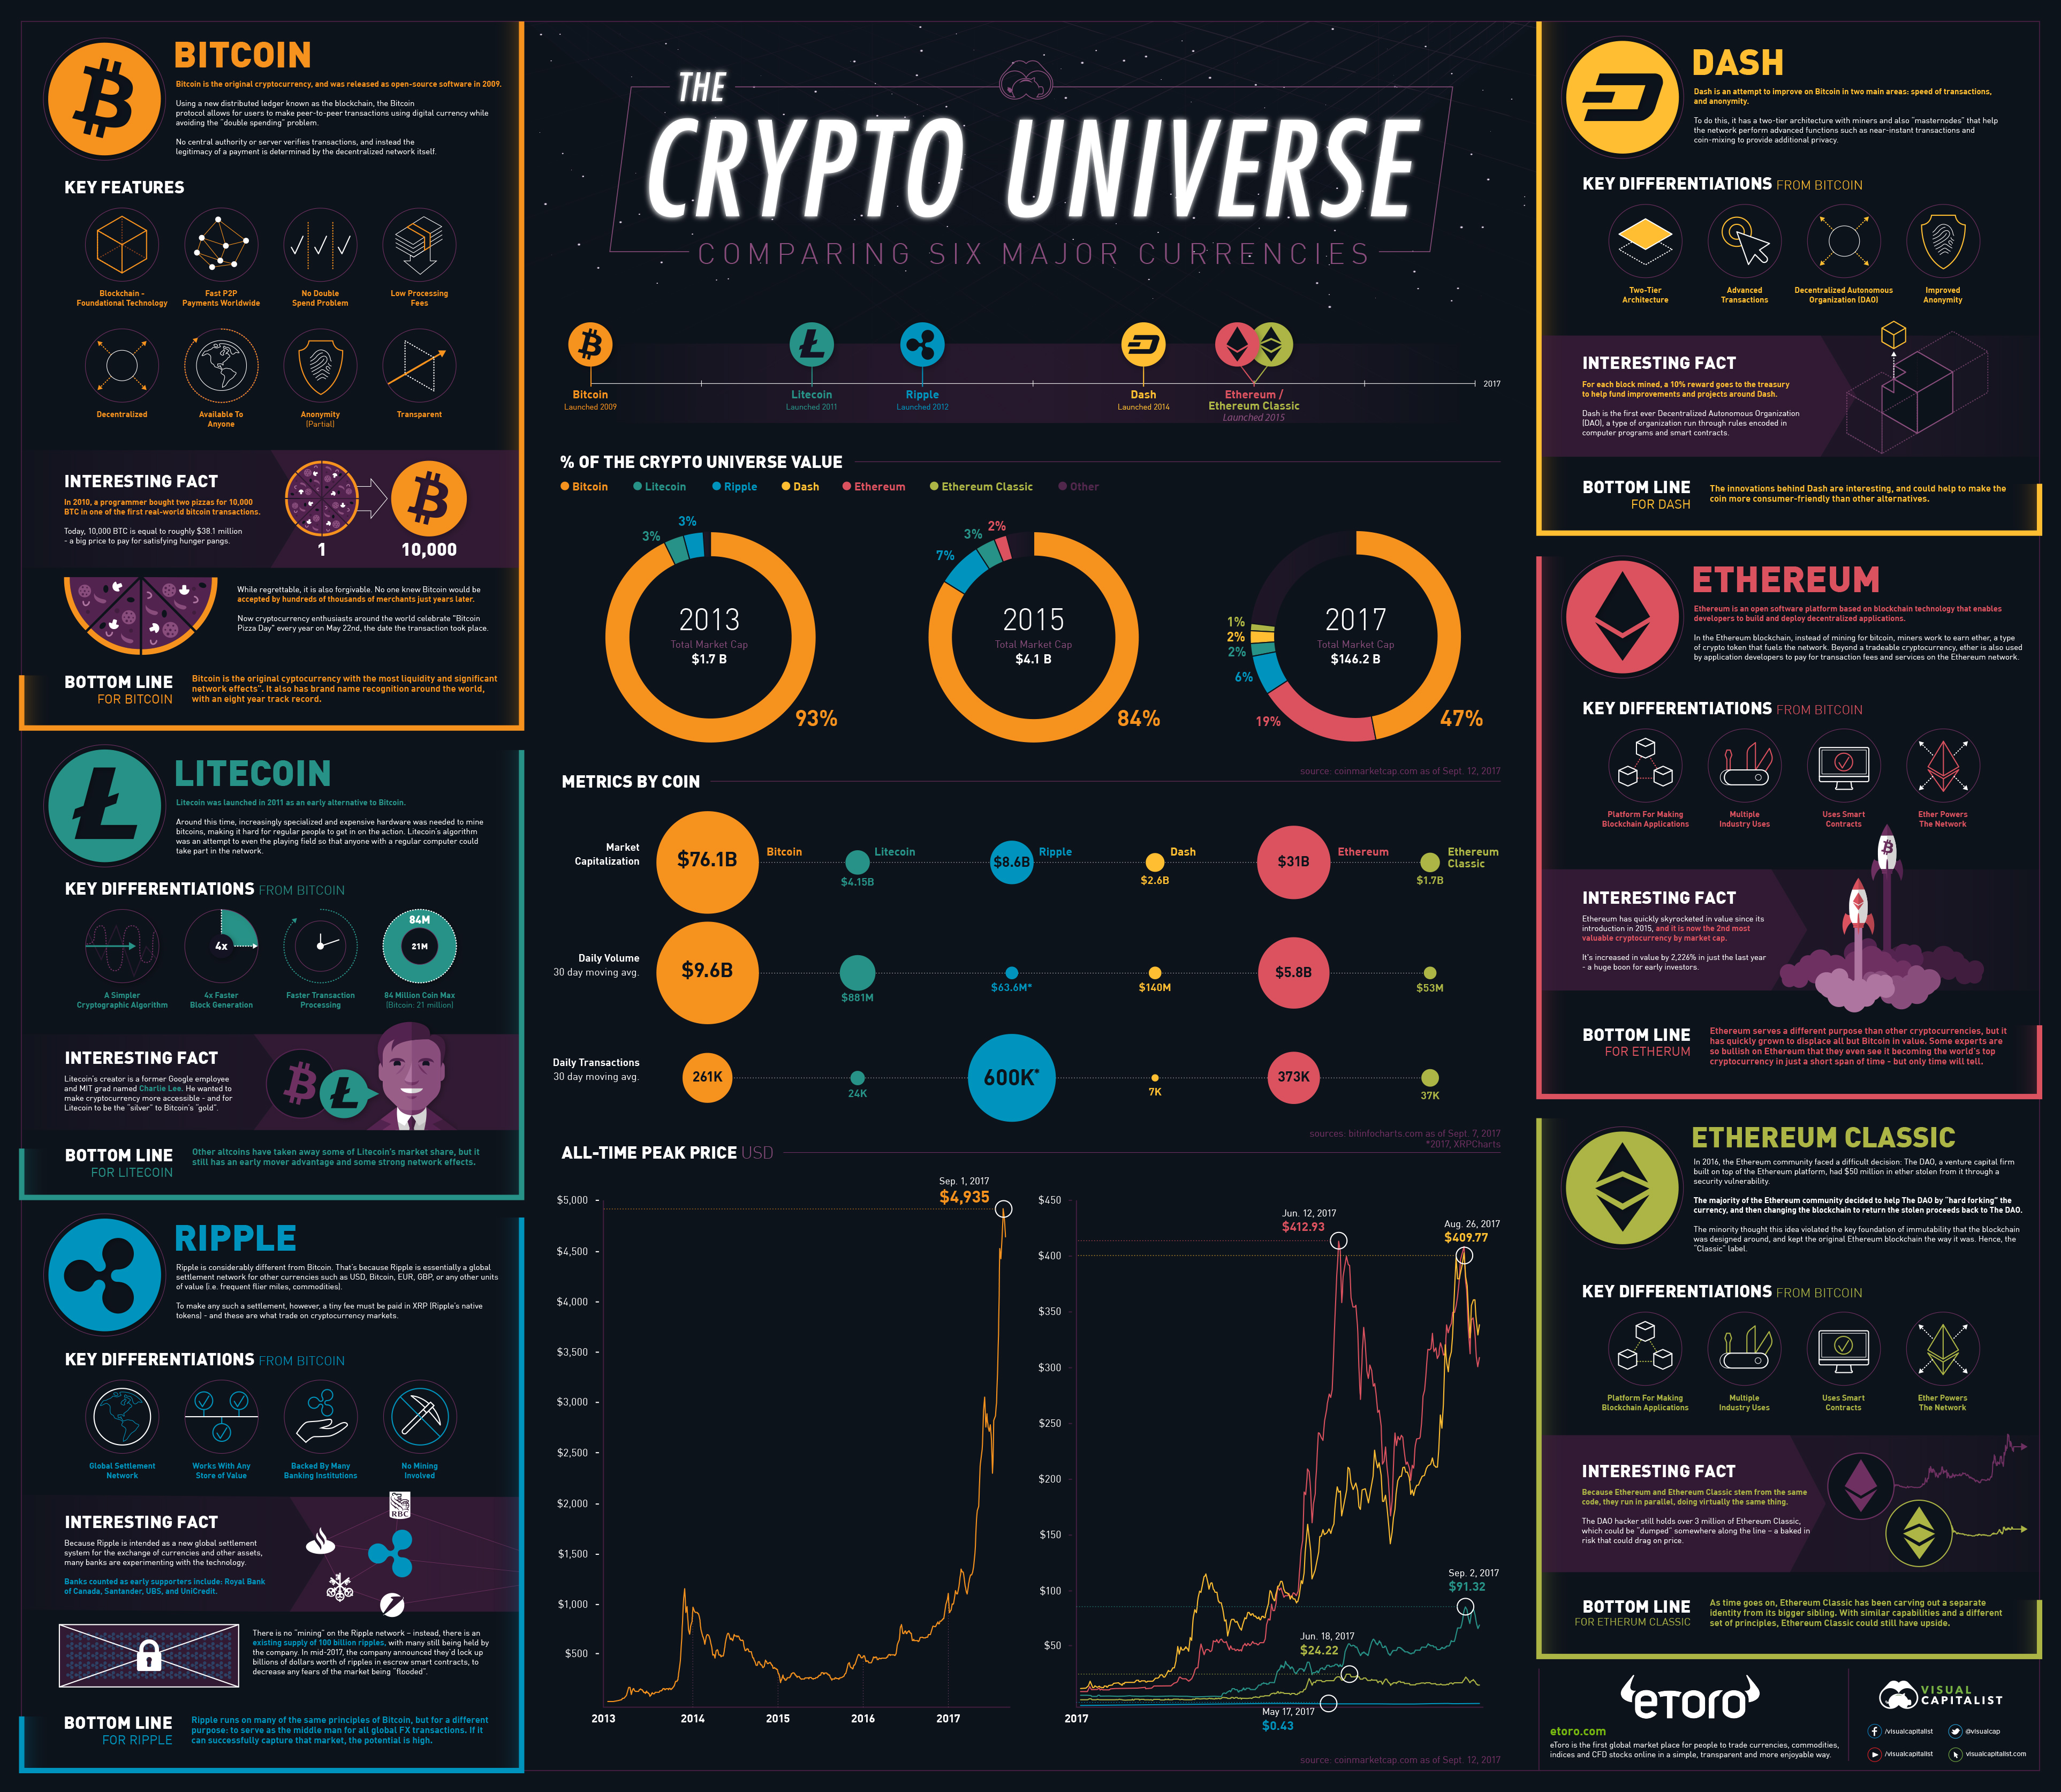

Slide 25
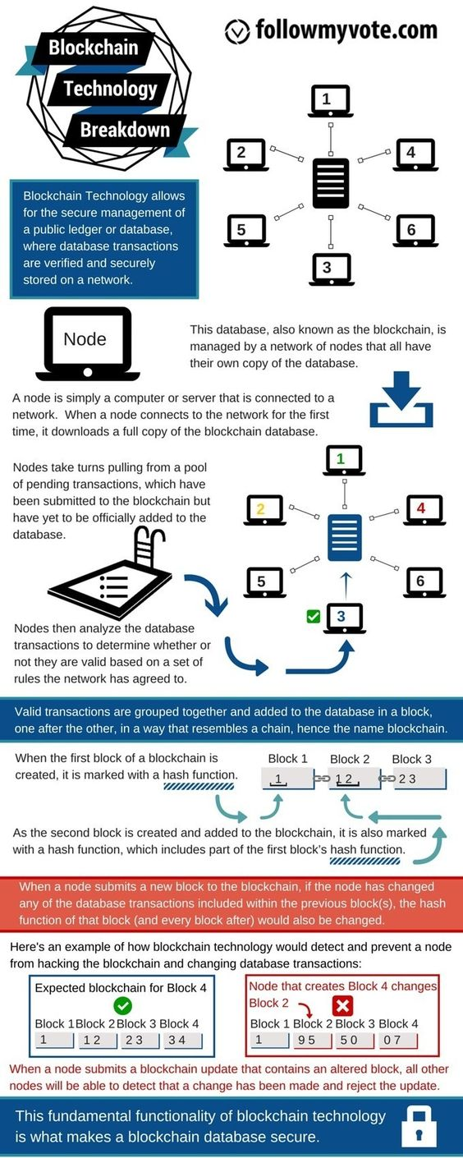

Slide 26
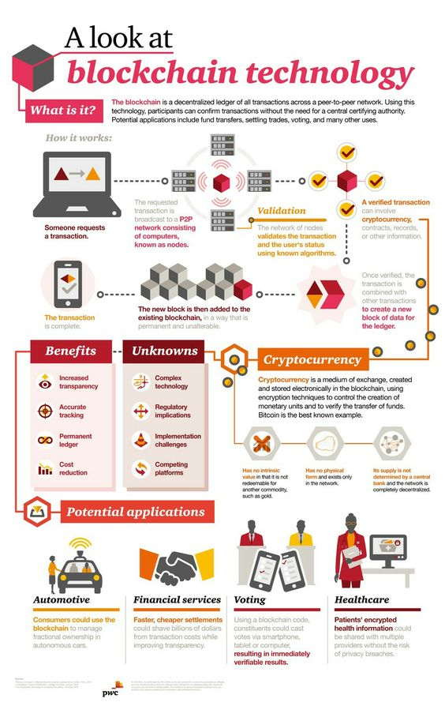

Slide 27
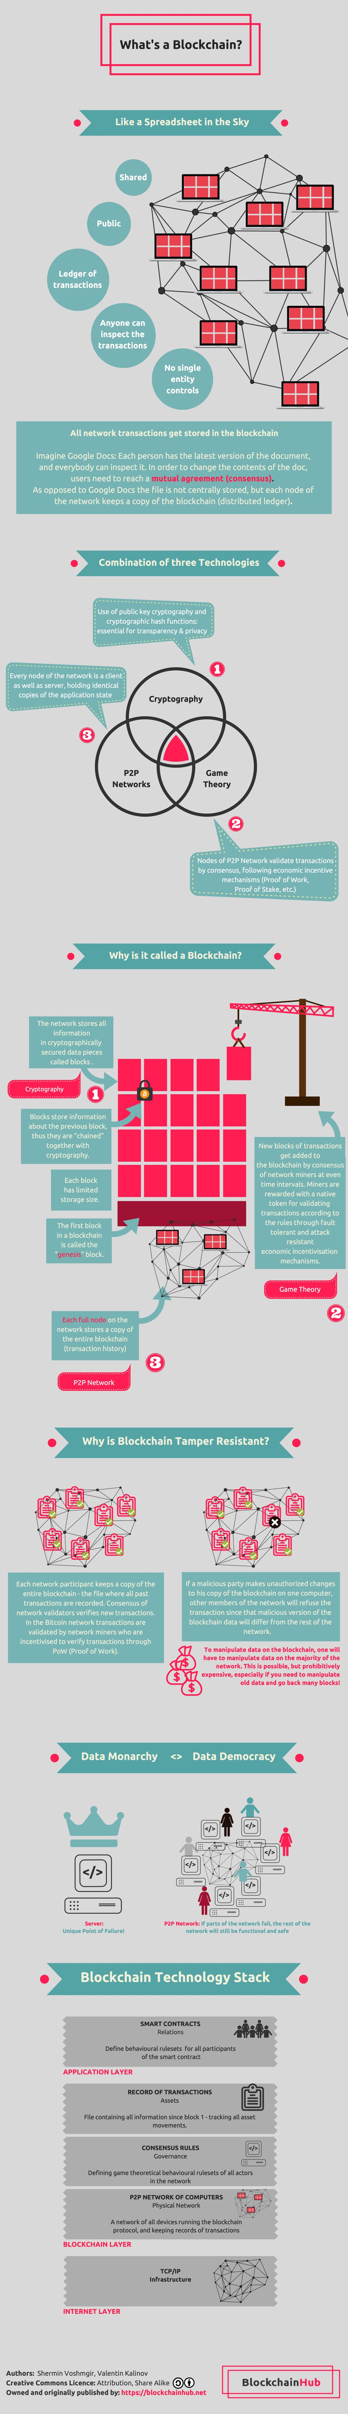

Slide 28
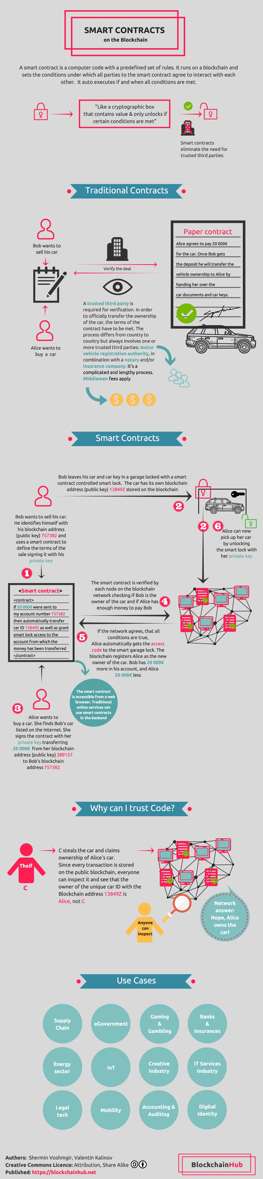

Slide 29
